Slide 1
Finger/Gripper Attachments (06/05/2020
Raghav Agarwal

Slide 2
Overview of this presentation:
Dimensions of meshes of different cages manufactured by Hexcyl and Seapa.
Exploring potential gripping fingers/robots that can be used.

Slide 3
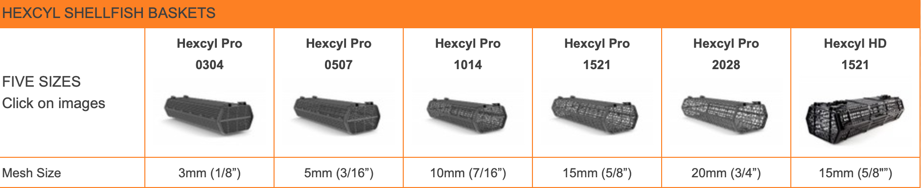
Hexcyl Cage Mesh Dimensions

Slide 4
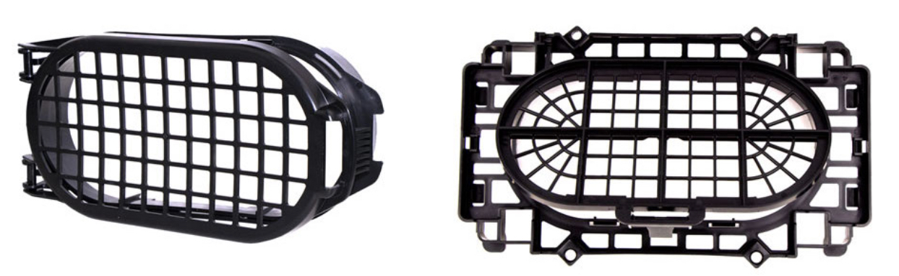
Seapa Cage Mesh Dimensions
Volume | Mesh Size
15 L | 3mm,6mm,12mm,20mm
25 L | 12mm,20mm

Slide 5
Sensing Requirements
Robotic grippers can be equipped with :
proprioceptive sensors (e.g., Hall‐effect sensors, encoders, torque sensors, tendon tension sensors) to estimate position and velocity of the gripper elements, and with
exteroceptive sensors (e.g., pressure sensors, optical sensors, resistive and conductive sensors, electromagnetic sensors) to gather information about the objects.

Slide 6
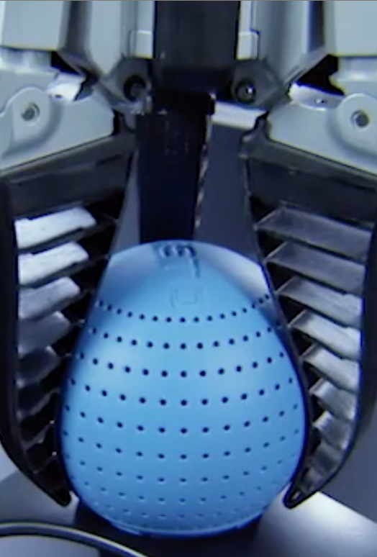
Fin Ray Gripper
Flexible but sturdy connection of the joints allows the gripper fingers to adapt to the contours of a work piece.
Grippers based on this method are actuated by external servomotors providing rotation or parallel movements of the grasping parts.
When the structure touches an object, it bends, conforming to the surface, grasping in response to the reaction forces.

Slide 7
Vacuum Based Soft Gripper
Used for gripping objects of odd geometries and/or an unusual surface.
Each gripper has three gripping fingers and a vacuum cavity, all made in one piece, resulting in a simple and robust product. As it is vacuum-driven, the gripping force is easily adjusted and controlled by the applied vacuum level.
This soft gripper can grip objects with a diameter of up to 50 mm.

Slide 8
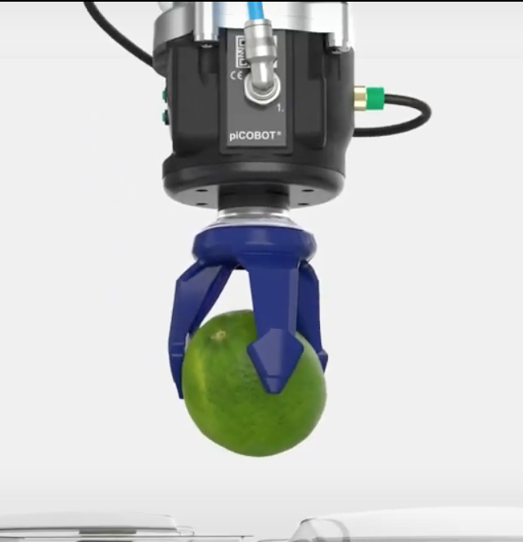
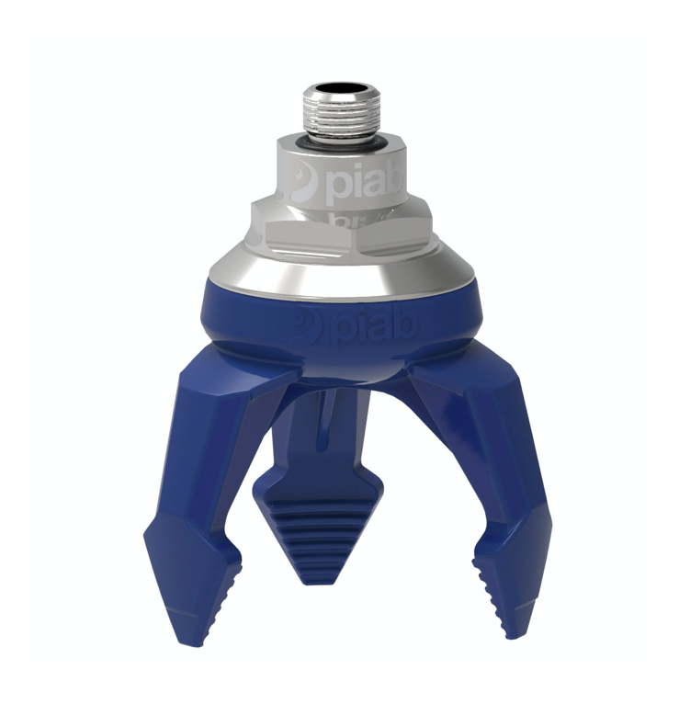

Slide 9
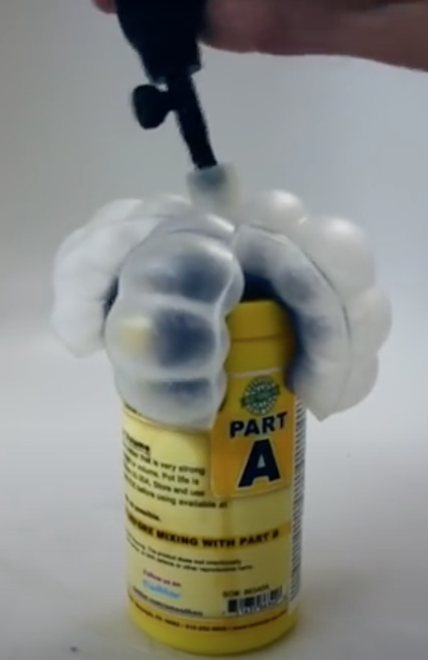
Air Powered Soft Robotic Gripper
CAD can be used to design a mold in the shape of the gripper user wants to build.
The mold is then filled with liquid silicone rubber. Eventually the rubber solidifies (this process is called curing) but is still soft and stretchy, which enables the robot to inflate like a balloon with air. The unique shape of the mold creates appendages that can bend, instead of just expanding like a regular balloon. This lets the appendages function as "fingers" for a gripping robot.
Click on this link for detailed explanation of the overall procedure in creating such grippers https://www.instructables.com/id/Air-Powered-Soft-Robotic-Gripper/

Slide 10
Disadvantages of using finger like gripper
This approach introduces hardware and software complexities.
These include large numbers of controllable joints.
The need for force sensing if objects are to be handled securely without crushing them.
A computational overhead to decide how much stress each finger should apply and where.

Slide 11
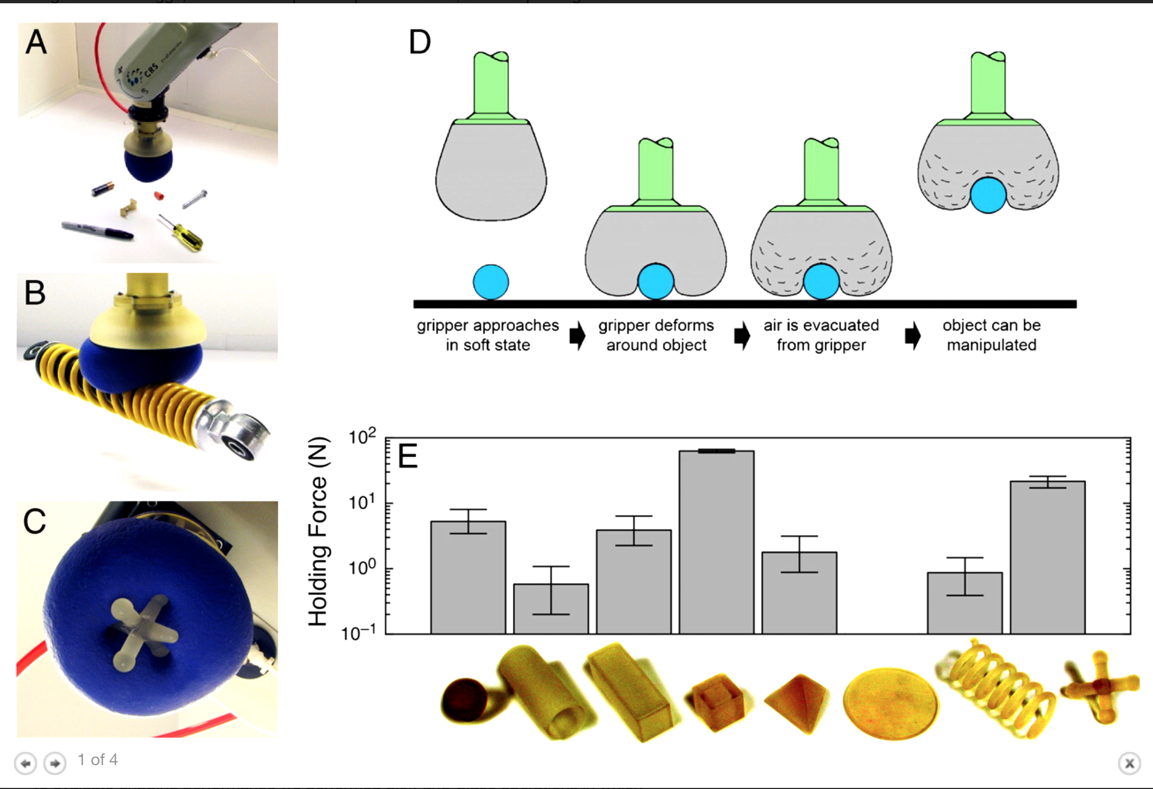
Solution - Particle Jamming
Individual fingers are replaced by a single mass of granular material that, when pressed onto a target object, flows around it and conforms to its shape. Upon application of a vacuum the granular material contracts and hardens quickly to pinch and hold the object without requiring sensory feedback.
This passive process reduces the number of elements to be controlled and therefore can have advantages in terms of reliability, cost, and gripping speed.

Slide 12
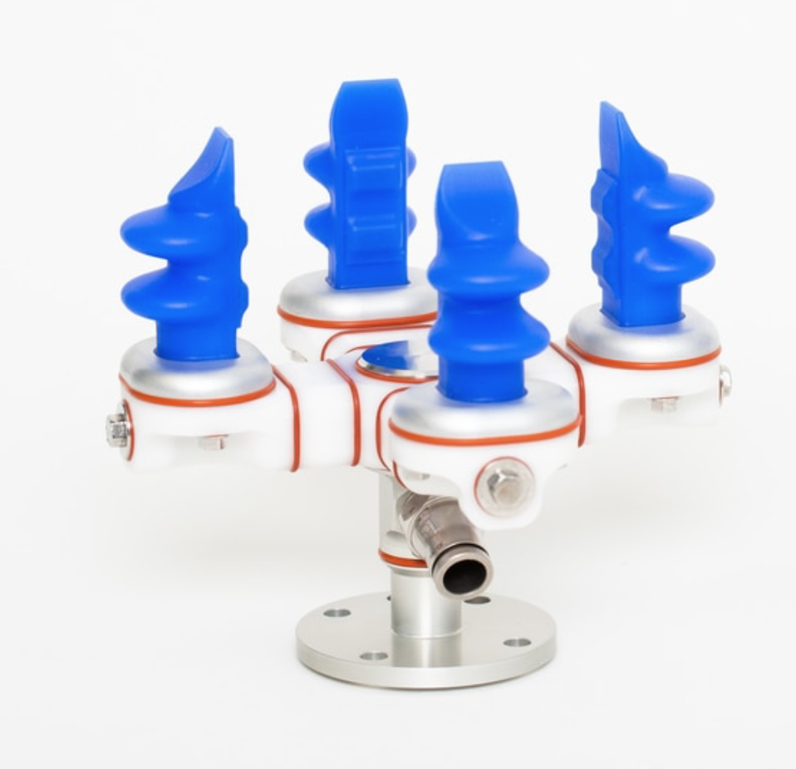
Soft Robotic Gripper
This flexible gripper has a soft pneumatic finger, which can adaptively cover the target object without pre-adjusting according to the precise size and shape of the object, and free from the production requirements of the traditional production line
The finger part of the jaw is made of flexible material, the grasping action is similar to the finger of the person, and it is flexible and can automatically wrap the product, thereby avoiding physical damage to the product.

Slide 13
Progress(06/06/2020)

Slide 14
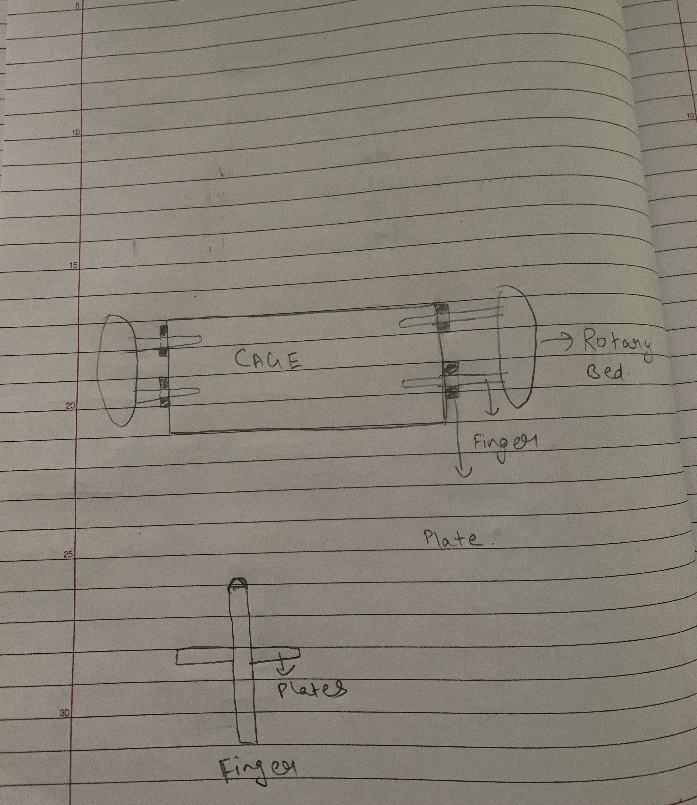
Design 1 : Fingers with plates
The fingers have plates attached on the sides.
The fingers are pushed into the mesh until the plate engages with the end cap.
These plates exetring surface normal force on the end caps, will constraint the cage when its being rotated during the cleaning cycle

Slide 15
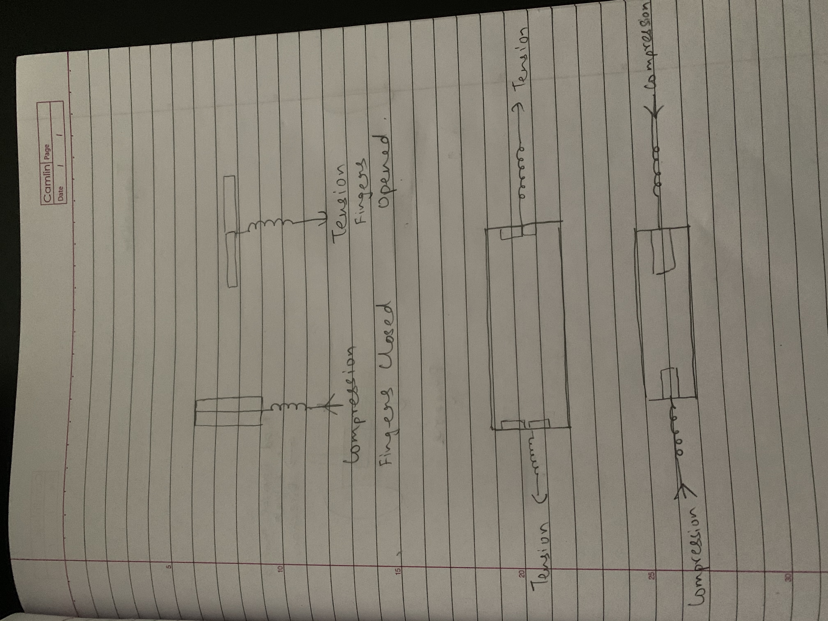
Design 2: Finger with a Spring system
The fingers will be attached to a spring.
As the fingers are introduced in the meshes, the spring will remain in compressed state.
After the fingers have been introduced into the mesh, tension will be applied to the finger.
The flaps of the finger will open up and then these flap will engage with the end caps.

Slide 16
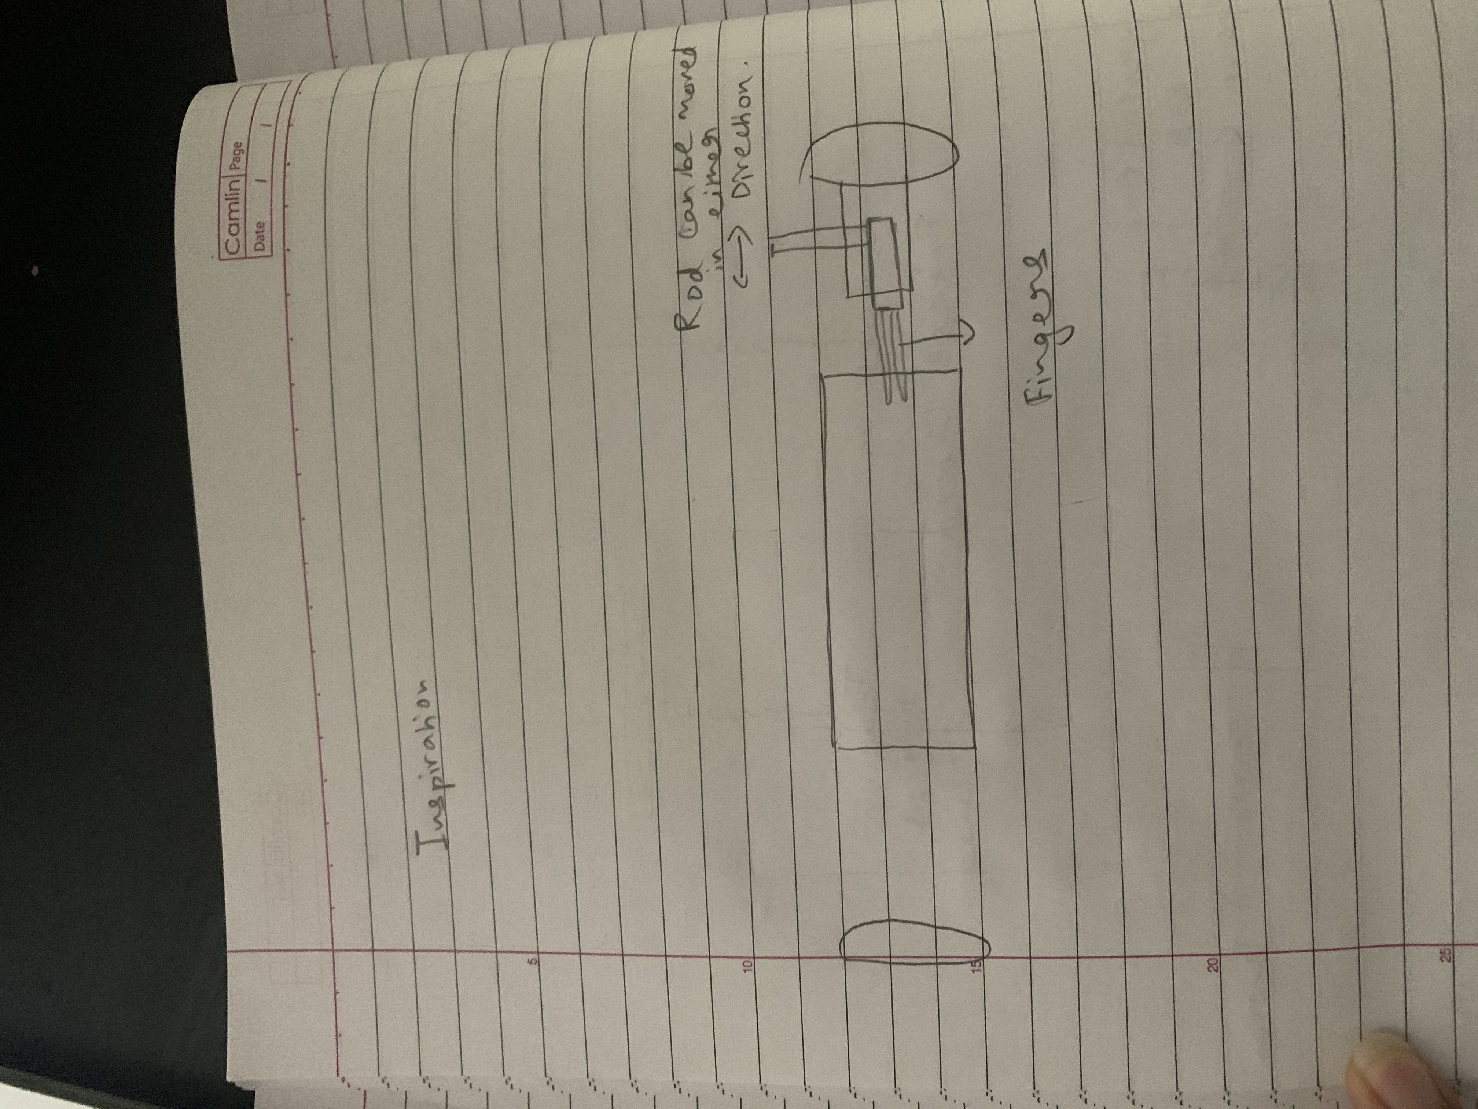
Design 3 : Fingers attached to a rod
This design is similar to design idea 2.
In this design idea, the fingers are attached to a metallic rod mounted on a handle.
As the handle is moved, the rod will push the fingers inside the mesh.

